Slide 1
Capstone Project
Sungeun Kim

Slide 2
Goal
This project is about finding a usable and more accessible pattern of PM2.5 to avoid outdoor activities if possible

Slide 3
Motivation
In recent years, particulate matter(a type of air pollution) has become the most concerned environmental and health issues among Korean. I moved to California almost 10 years ago, I personally did not experience this issue until this year. I experienced burning sensation in eyes and temporary respiratory symptoms such as coughing. Therefore, I wanted to find out the pattern of PM2.5.

Slide 4
What is PM2.5?
According to EPA(United States Environmental Protection Agency), Particulate Matter (PM2.5) is a particle less than 2.5 micrometers in diameter that can be inhaled and cause serious health problems.

Slide 5
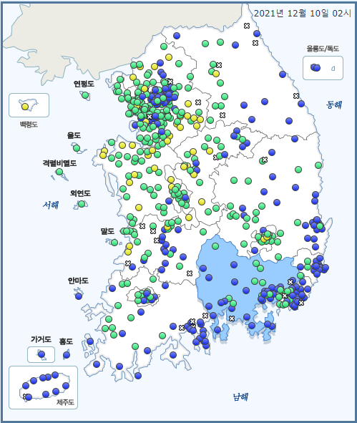
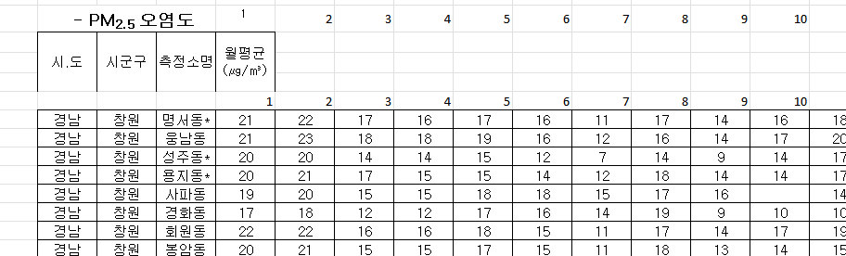
Data Discovery
I found my dataset from:
https://www.airkorea.or.kr/web
And I picked one specifically around where I live which is Gyeongsangnam-do(경상남도)

Slide 6
Data Discovery
From that data, certain cities had higher level of average PM2.5 level than others.
For example, Jinyeong-eup(진영읍) had the highest level of PM2.5
So, I found another data set specifically from Jinyeong-eup(진영읍)

Slide 7
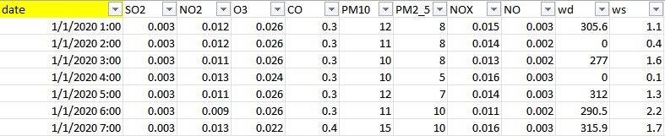
Data Discovery
The excel file has various data collected from that city every hour in 2020.
Since my goal of this project is to find a pattern that is accessible to anyone, I will be focusing on wind speed(ws) and wind direction(wd) which can be easily found from any weather app.

Slide 8
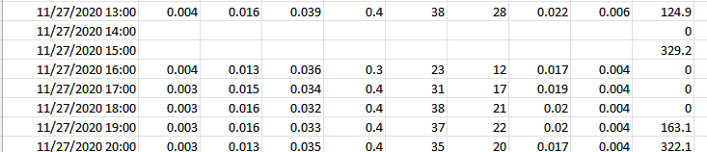
Issues with the dataset
The main problem with the dataset was empty data. So I manually deleted those rows.

Slide 9
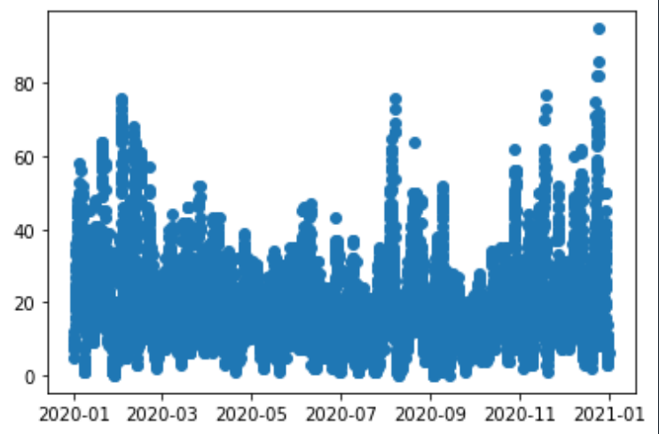
Exploratory analysis
From plt.plot_date, except that peak in August, PM2.5 level is higher between October to February

Slide 10
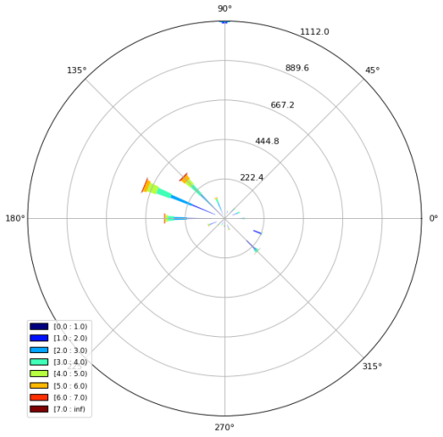
Exploratory analysis
From windrose, it shows the overall wind direction and wind speed between October to February. And Northwest wind is most common

Slide 11

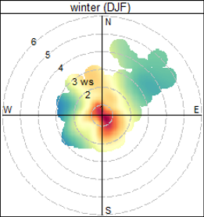
Exploratory analysis
From polarPlot in R,
It shows the wind speed, wind direction, and level of PM2.5.
Among that, we can notice that PM2.5 is the higher when the wind speed is less than 2 and direction of southeast

Slide 12
Model design and implementation
Since Korea has wind direction of Southeast during summer and Northwest during winter, having high level of PM2.5 in direction of Southeast during winter is unusual. Therefore, “IF” there is some slight Southeast wind during winter, we can assume that the PM2.5 level would be higher than usual.

Slide 13
Society/Community impact
Since with any weather apps, it shows the wind direction and the wind speed, the result of this project can help people to know when the PM2.5 level is higher than usual with a simple tool to protect themselves.

